Slide 1
Experimentally Informed Site-Specific Substitution Models Substantially Deepen Divergence Estimates
Notes:
Color scheme
black = "black”
blue = "#439FC3”
green = "#397262”
orange = "#F9842A”
red = "#B52A24”
pink = "#CC79A7"

Slide 2
Notes
The raw figures come from `figures.ipynb` in this directory.
If you don’t change the size of the output figure you should be able to plop them into this presentation to produce the final figures.

Slide 3
MAIN FIGURES

Slide 4
Model feature comparison

Slide 5
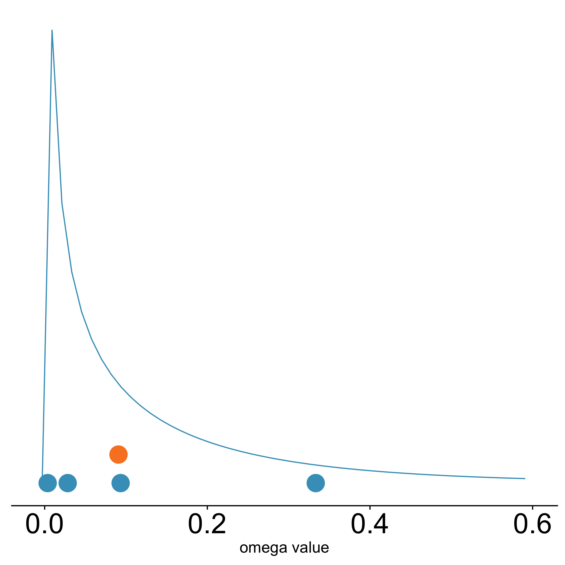
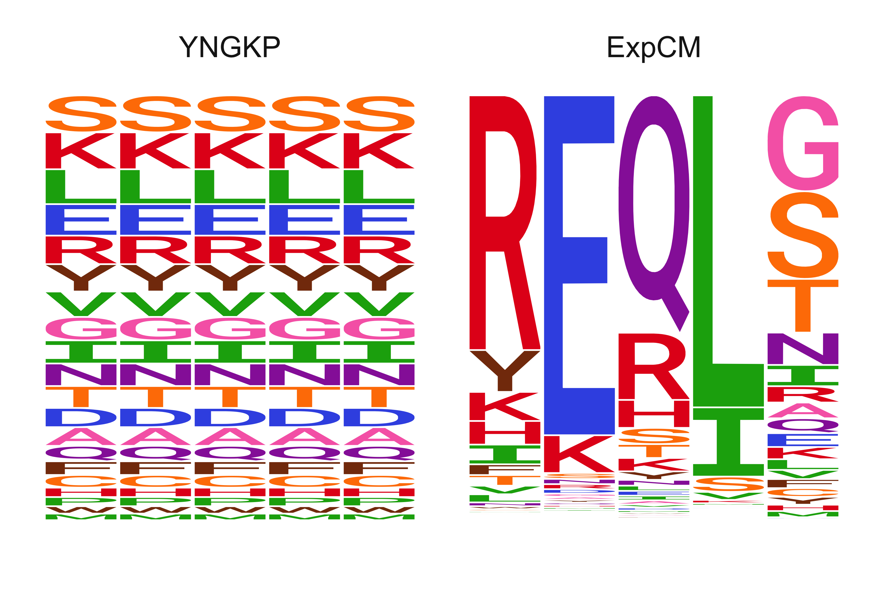

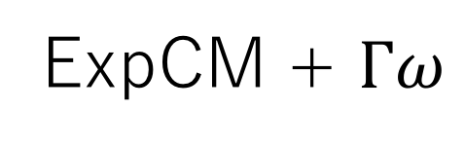
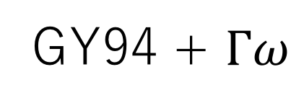
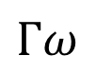
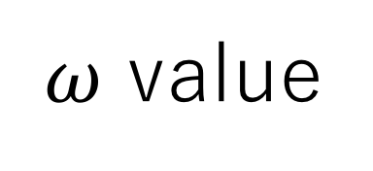
A
B
C
Uniform stationary state
Non-uniform stationary state
Non-uniform stationary state
$Γω$ rate variation
GY94
GY94 + $Γω$
ExpCM
ExpCM + $Γω$
$ω$ value
$$Γω$$
single value

Slide 6
Decay to stationary state

Slide 7
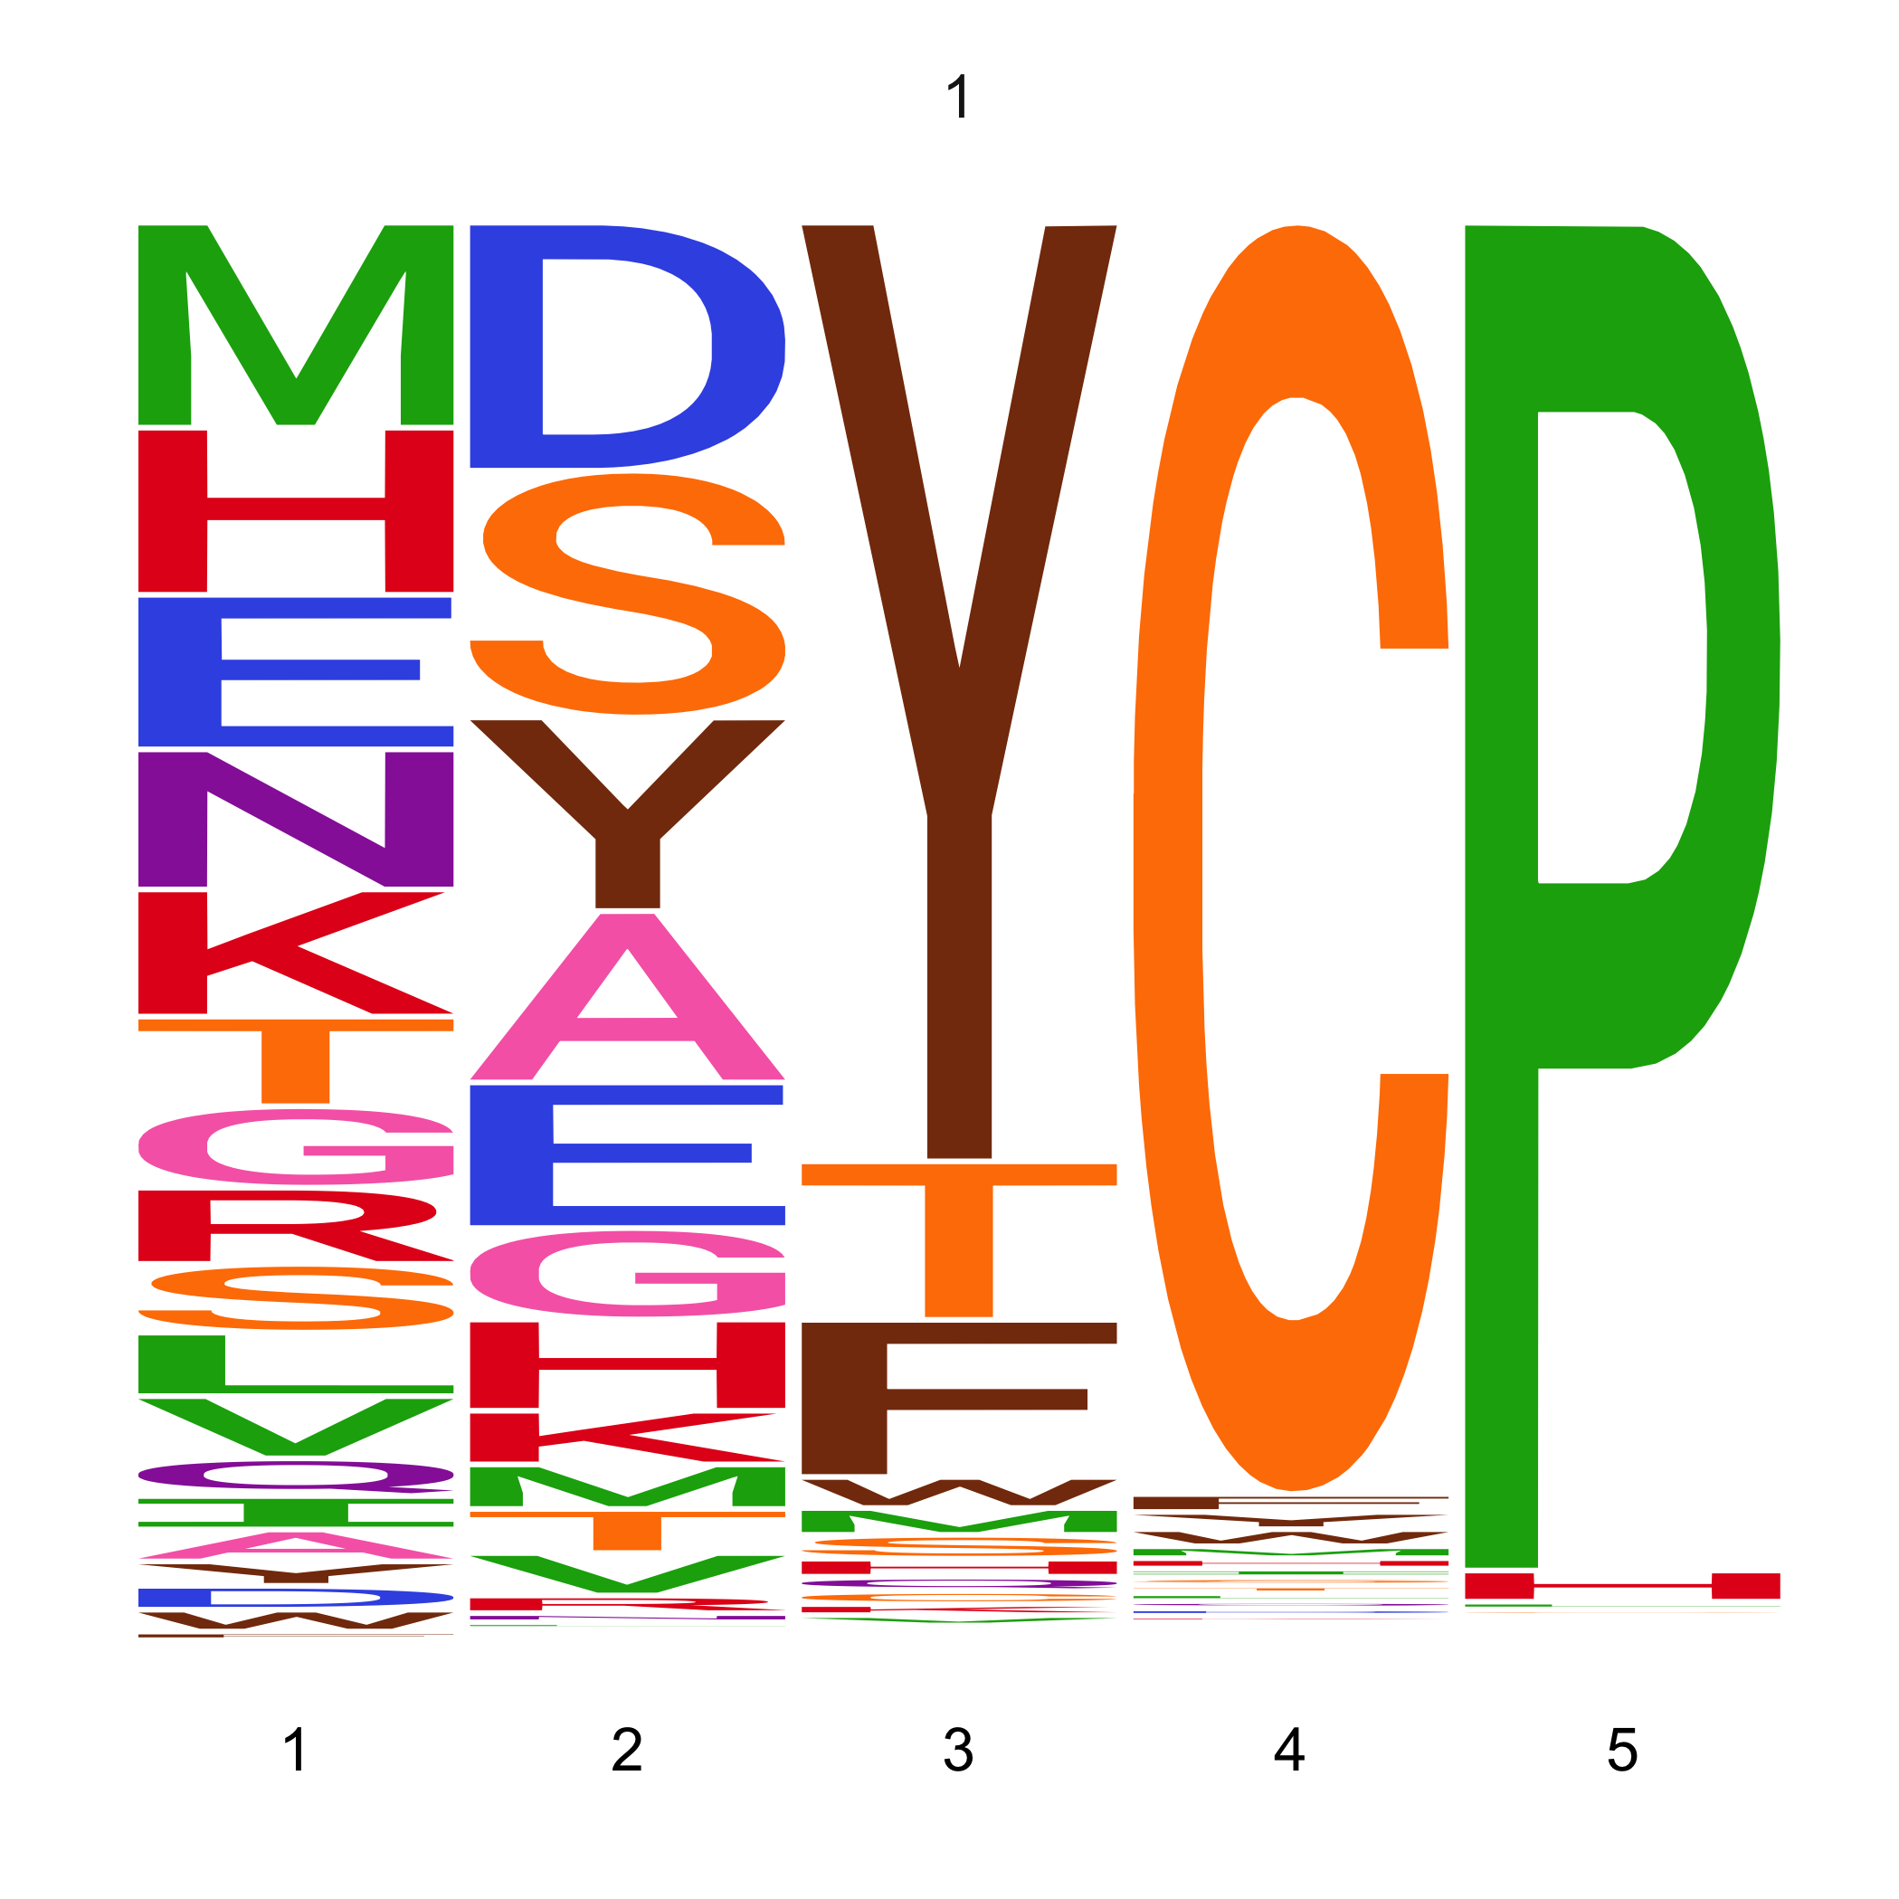
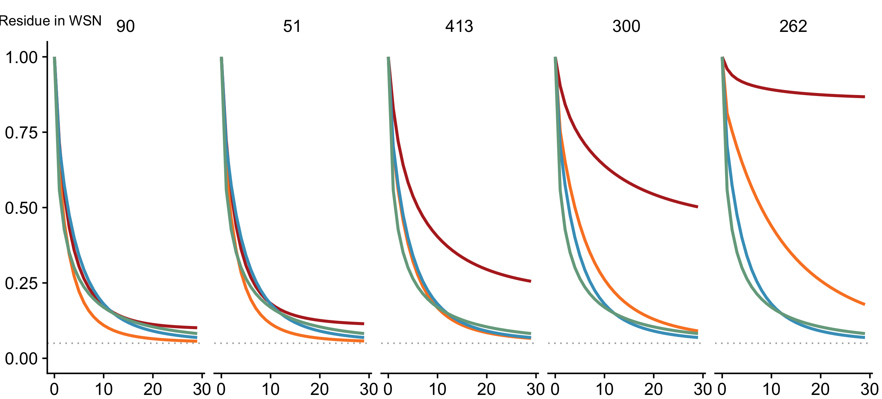
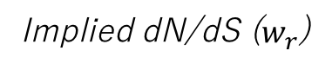
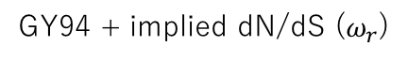
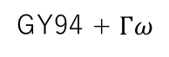
90
51
413
300
262
Site in HA
0.80
0.61
0.27
0.18
0.06
Implied dN/dS ($w_{r}$)
Model
ExpCM
Expected pairwise amino-acid identity per site
GY94
GY94 + $Γω$
GY94 + implied dN/dS ($ω_{r}$)
Branch length (codon substitutions per site)

Slide 8
Simulations

Slide 9
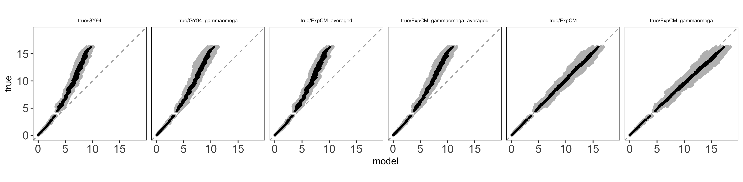
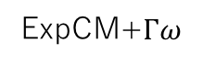
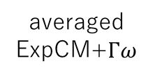
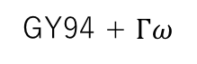
averaged
ExpCM
averaged
ExpCM+$Γω$
GY94
GY94 + $Γω$
ExpCM
ExpCM+$Γω$
Actual branch length
Branch length optimized by the model

Slide 10
Model Comparison Trees

Slide 11
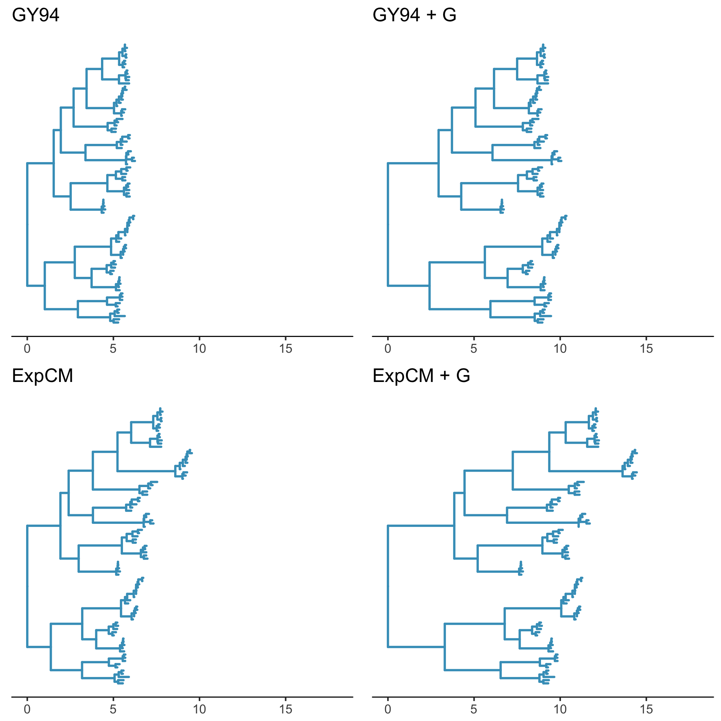
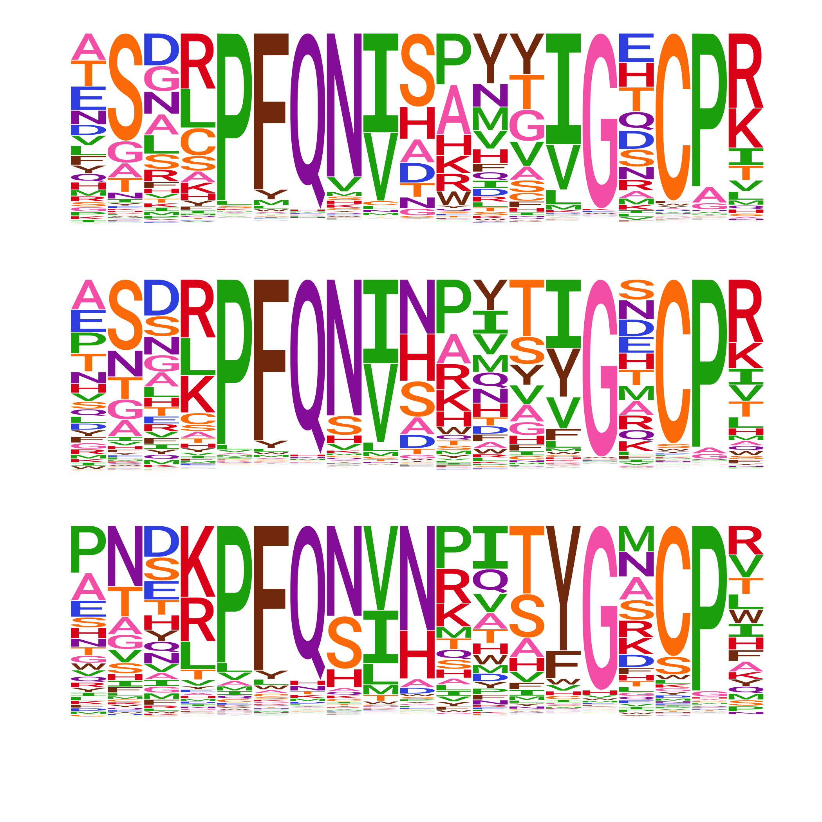
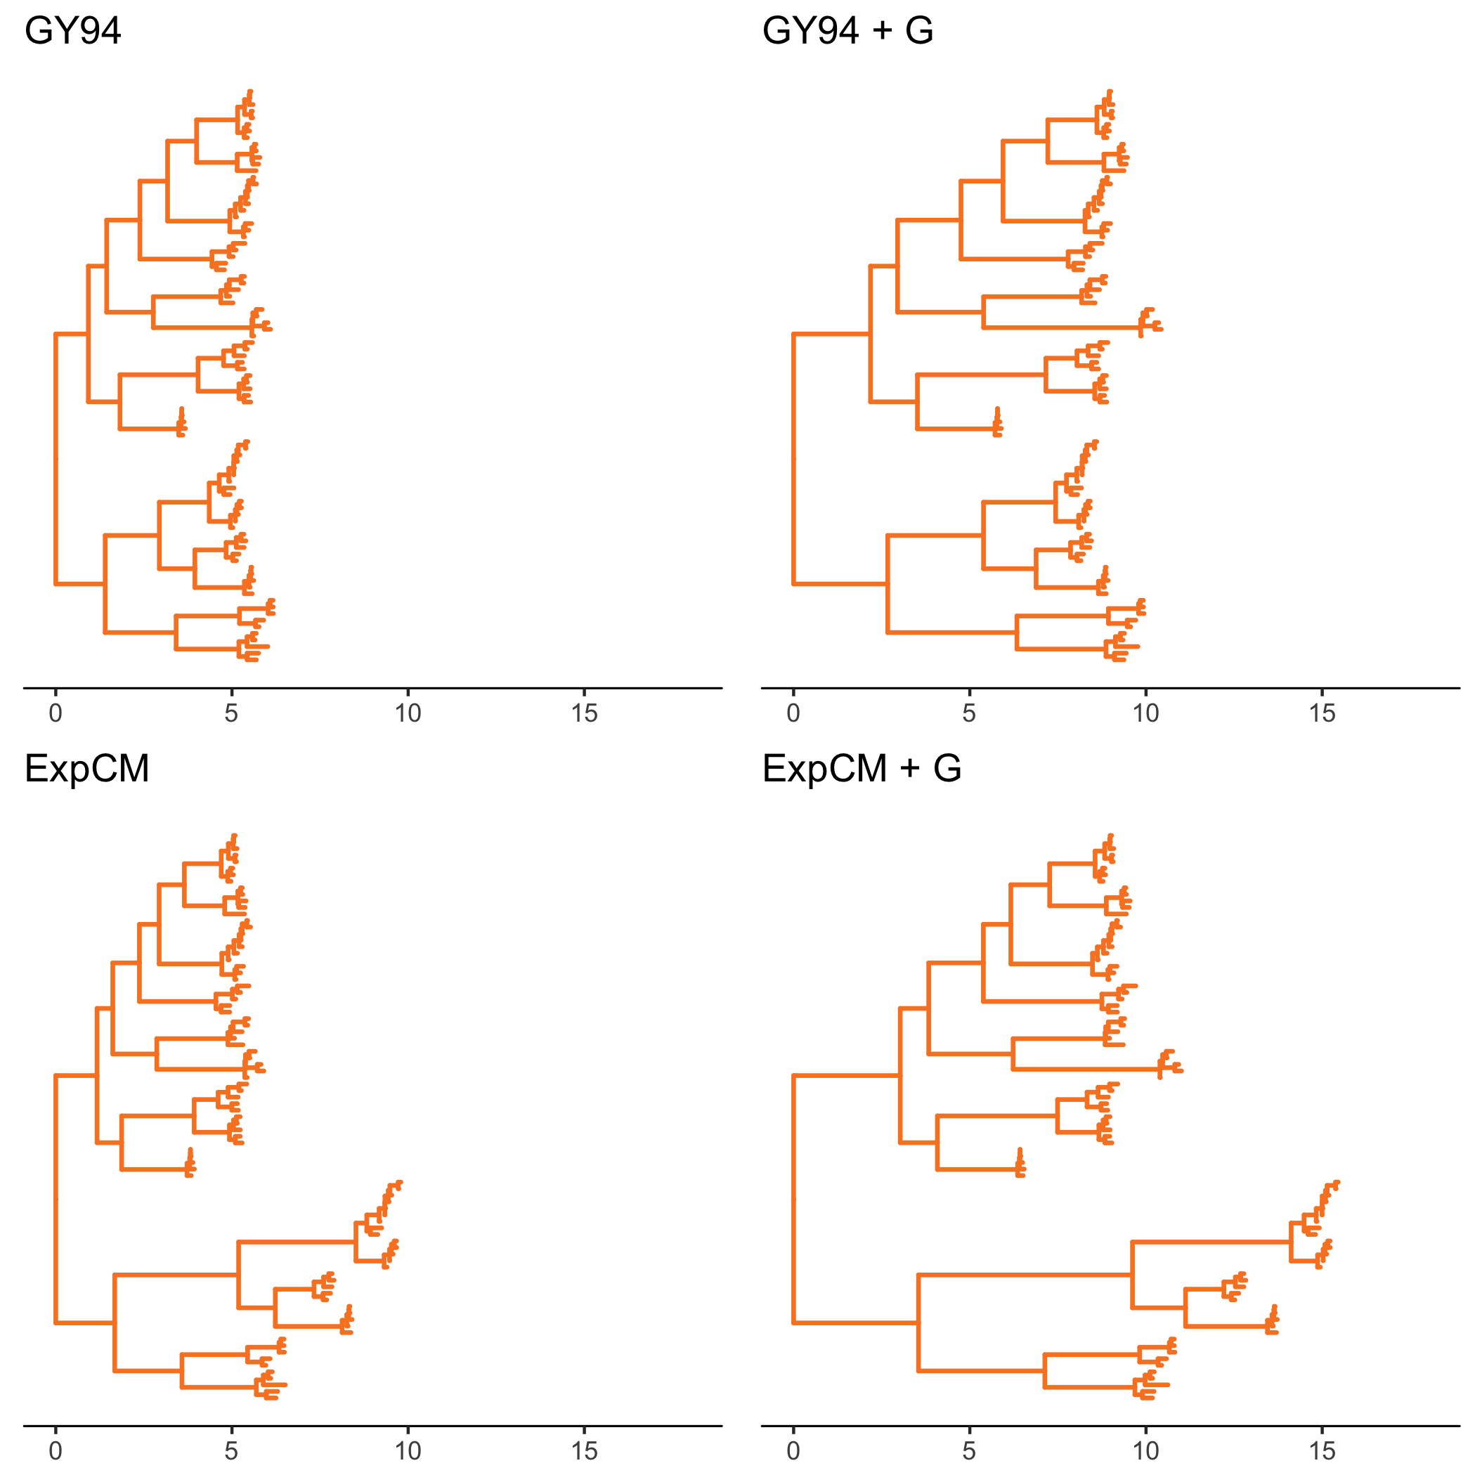
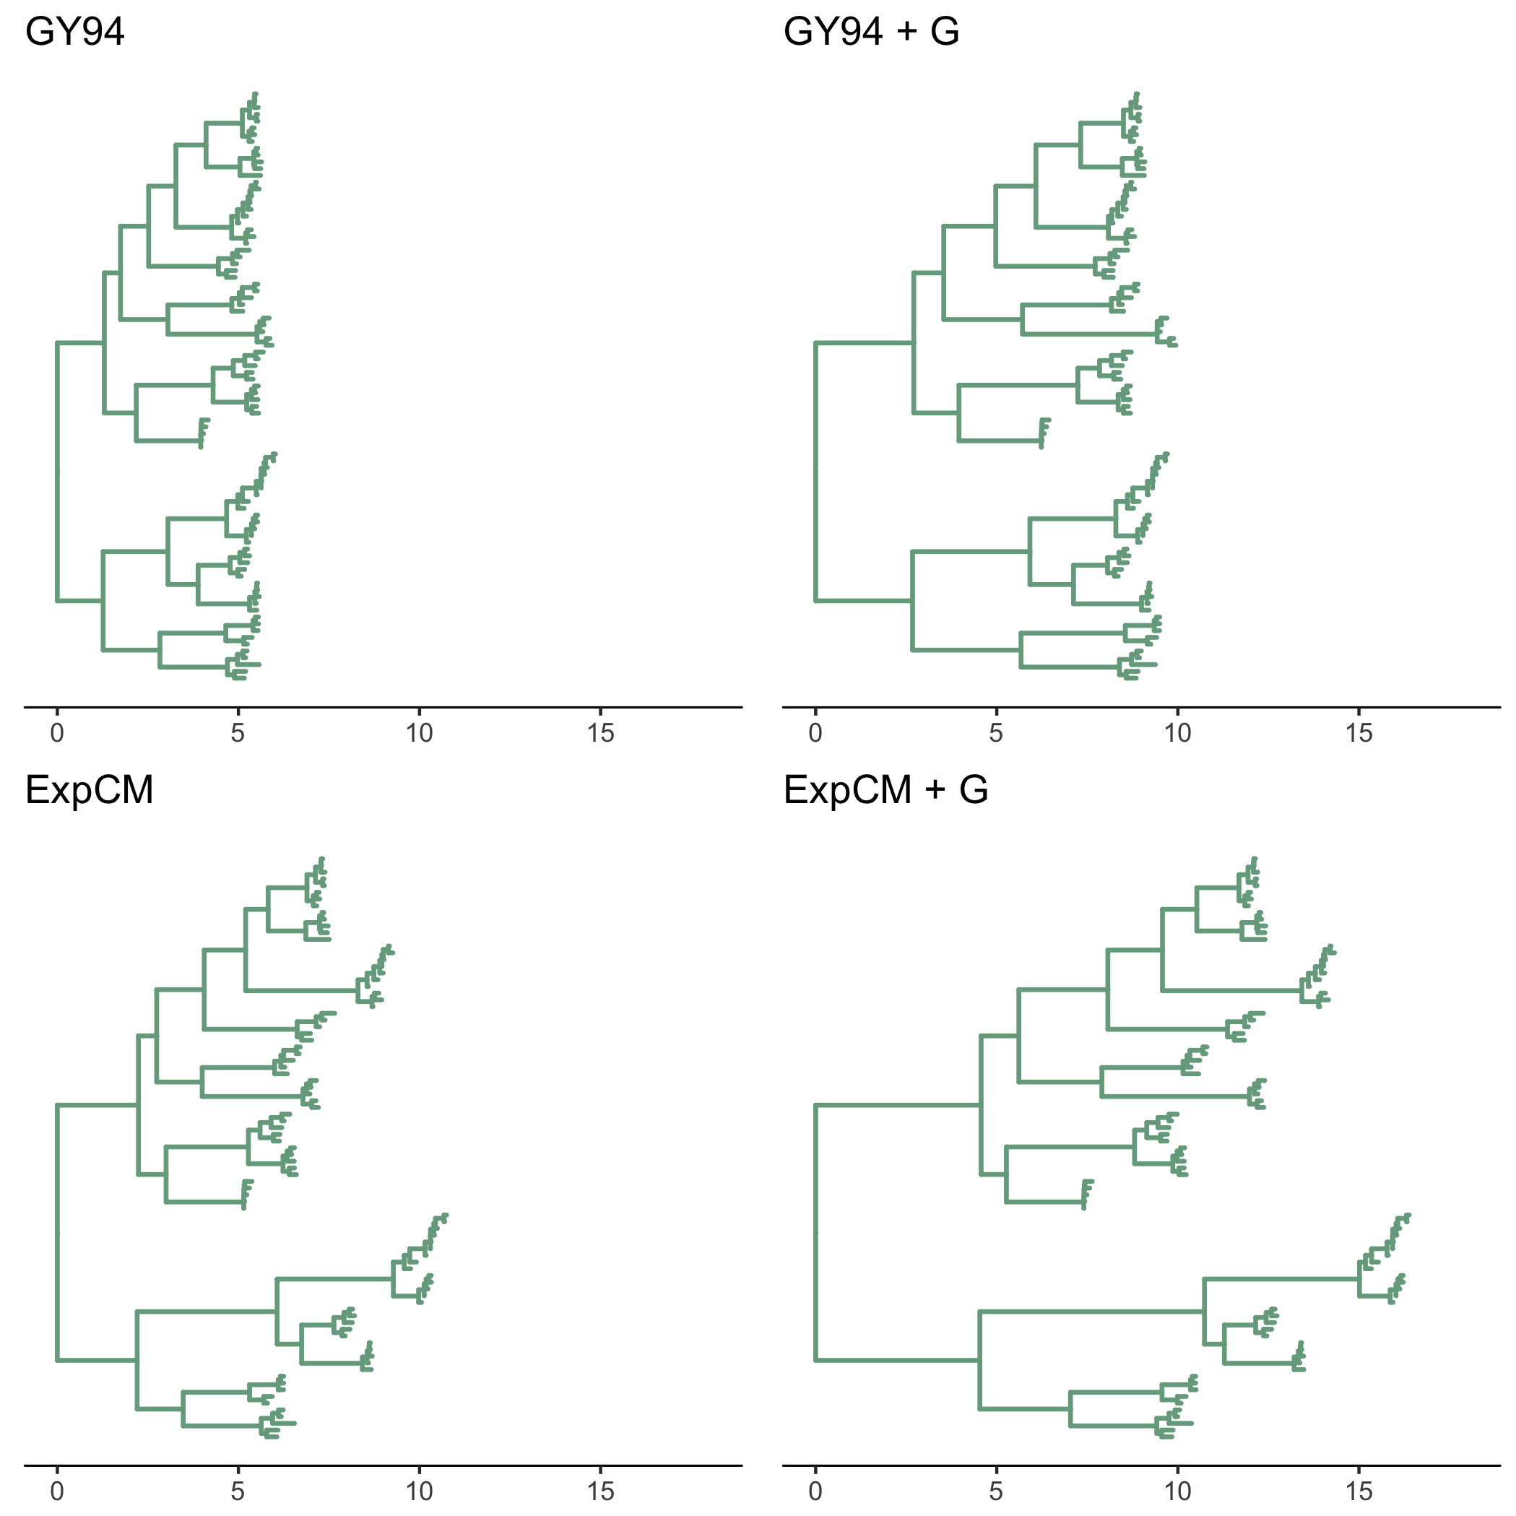
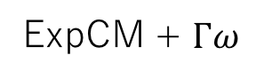
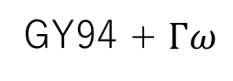
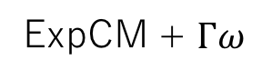

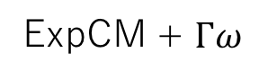
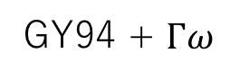
A
B
GY94
GY94 + $Γω$
H1
average
ExpCM
ExpCM + $Γω$
H3
C
D
GY94
GY94 + $Γω$
GY94
GY94 + $Γω$
ExpCM
ExpCM + $Γω$
ExpCM
ExpCM + $Γω$

Slide 12
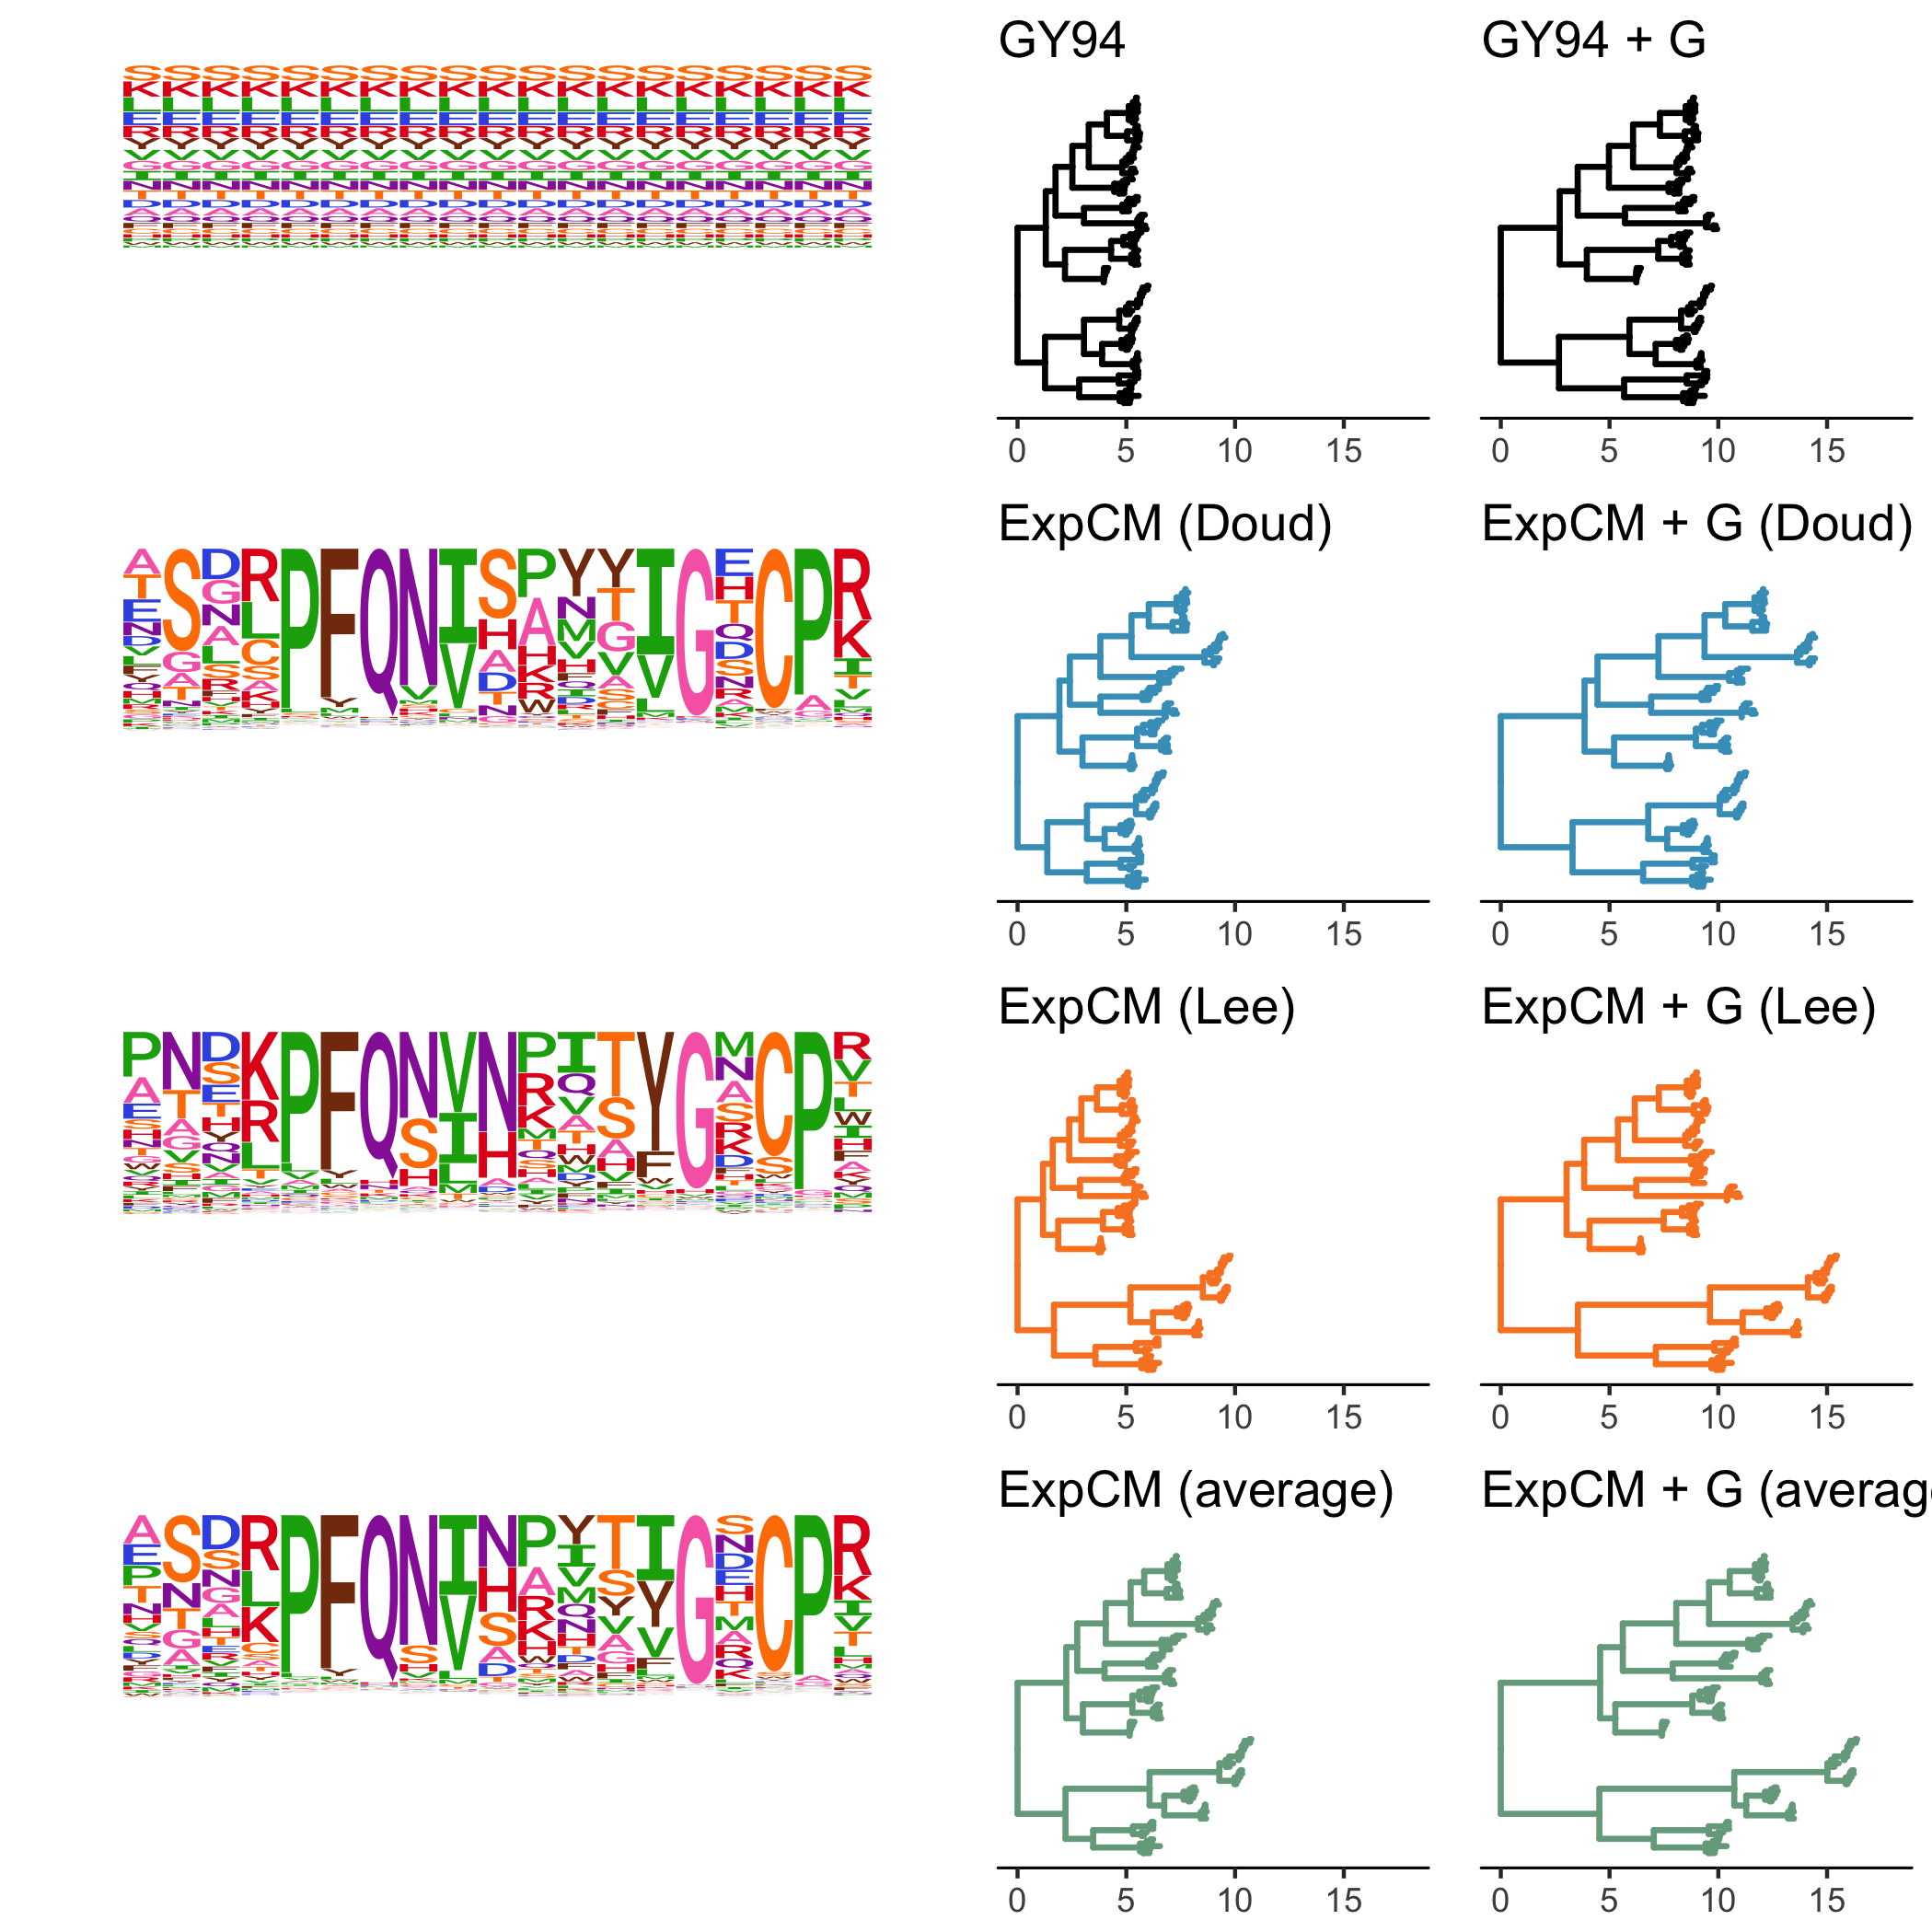
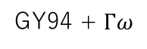
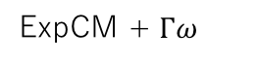
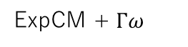

GY94
GY94 + $Γω$
GY94 family
ExpCM
ExpCM + $Γω$
H1 preferences
ExpCM
ExpCM + $Γω$
H3 preferences
ExpCM
ExpCM + $Γω$
average preferences

Slide 13
Competing effects

Slide 14
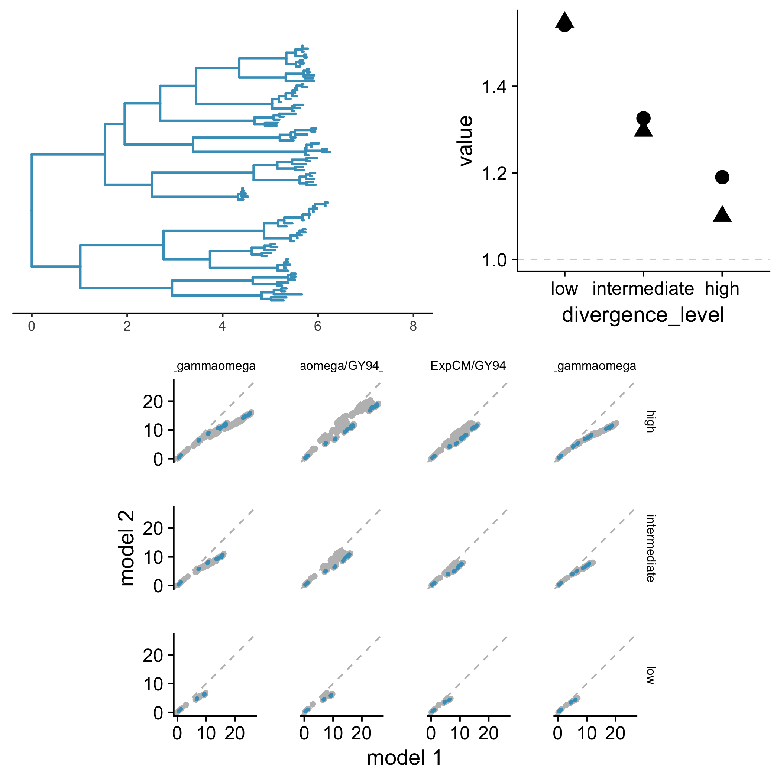
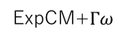

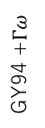
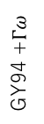
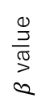
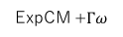
A
B
high
ExpCM
ExpCM +$Γω$
low
$β$ value
intermediate
low
high
intermediate
C
ExpCM
GY94 +$Γω$
GY94
GY94
high
Branch from focal sequence?
Yes
No
ExpCM
GY94 +$Γω$
GY94
GY94
intermediate
ExpCM
GY94 +$Γω$
GY94
GY94
low
ExpCM+$Γω$
ExpCM+$Γω$
ExpCM
YNGKP M5

Slide 15
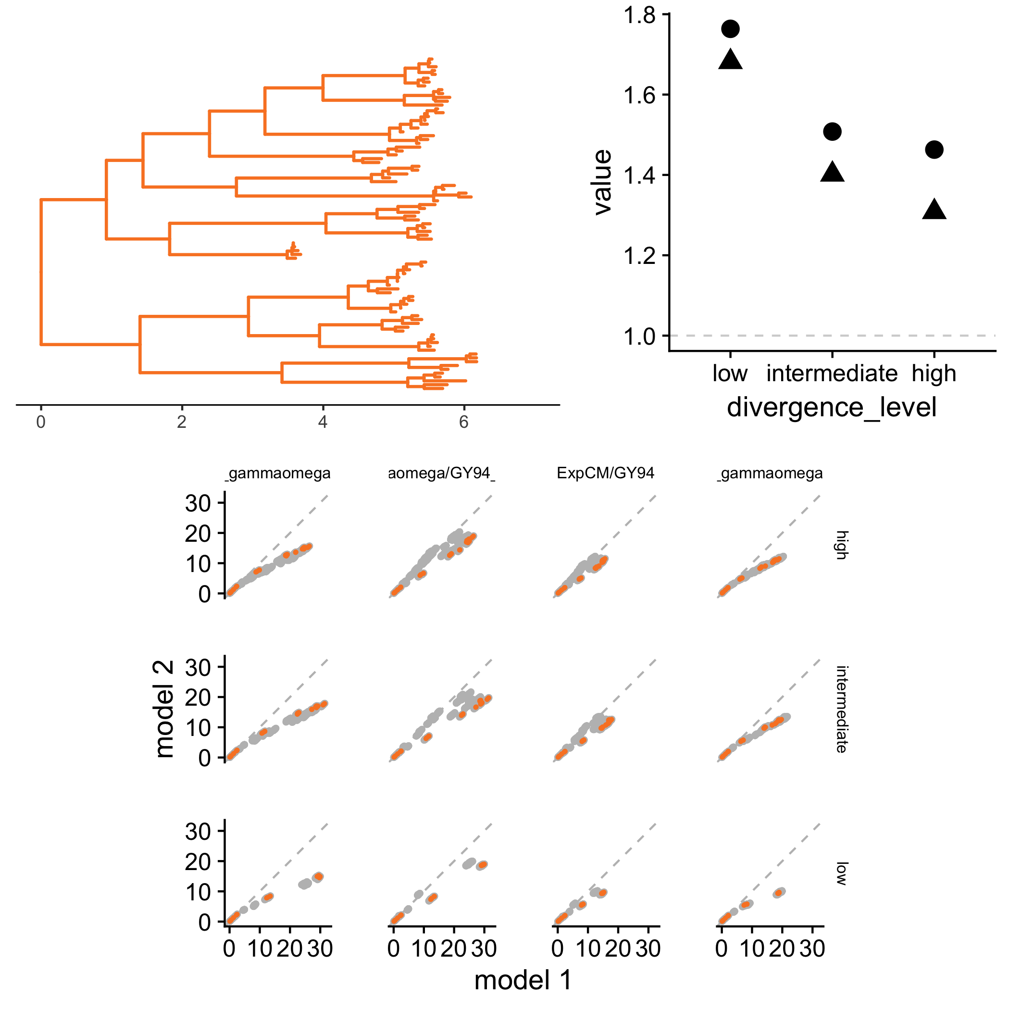
A
B
high
ExpCM
ExpCM +$Γω$
intermediate
$β$ value
low
low
high
intermediate
C
ExpCM
GY94 +$Γω$
GY94
GY94
high
Branch from focal sequence?
Yes
No
ExpCM
GY94 +$Γω$
GY94
GY94
intermediate
ExpCM
GY94 +$Γω$
GY94
GY94
low
ExpCM+$Γω$
ExpCM+$Γω$
ExpCM
YNGKP M5

Slide 16
SUPPLEMENTAL FIGURES

Slide 17
Preference Sets

Slide 18
Notes:
Doud, stringency 1.21

Slide 19
Notes:
Lee stringency 1.46

Slide 20
Notes:
Average, stringency 1.82

Slide 21
Full Experiments

Slide 22
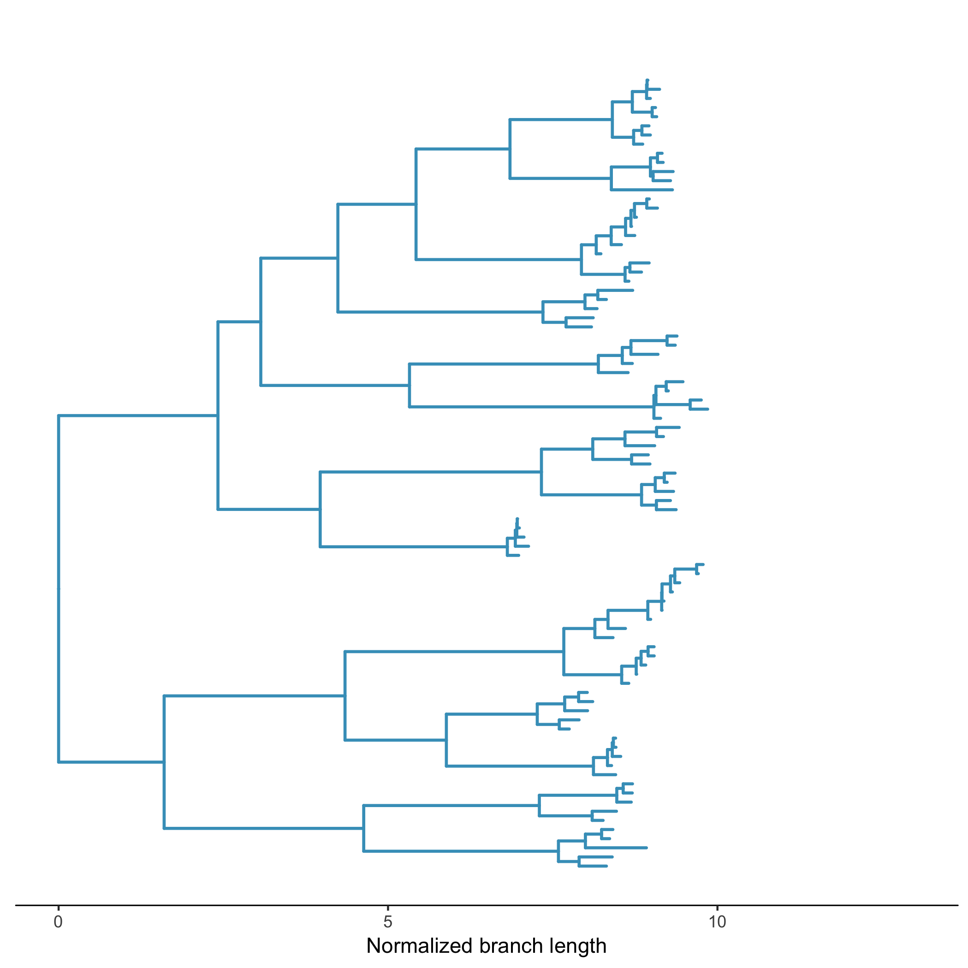
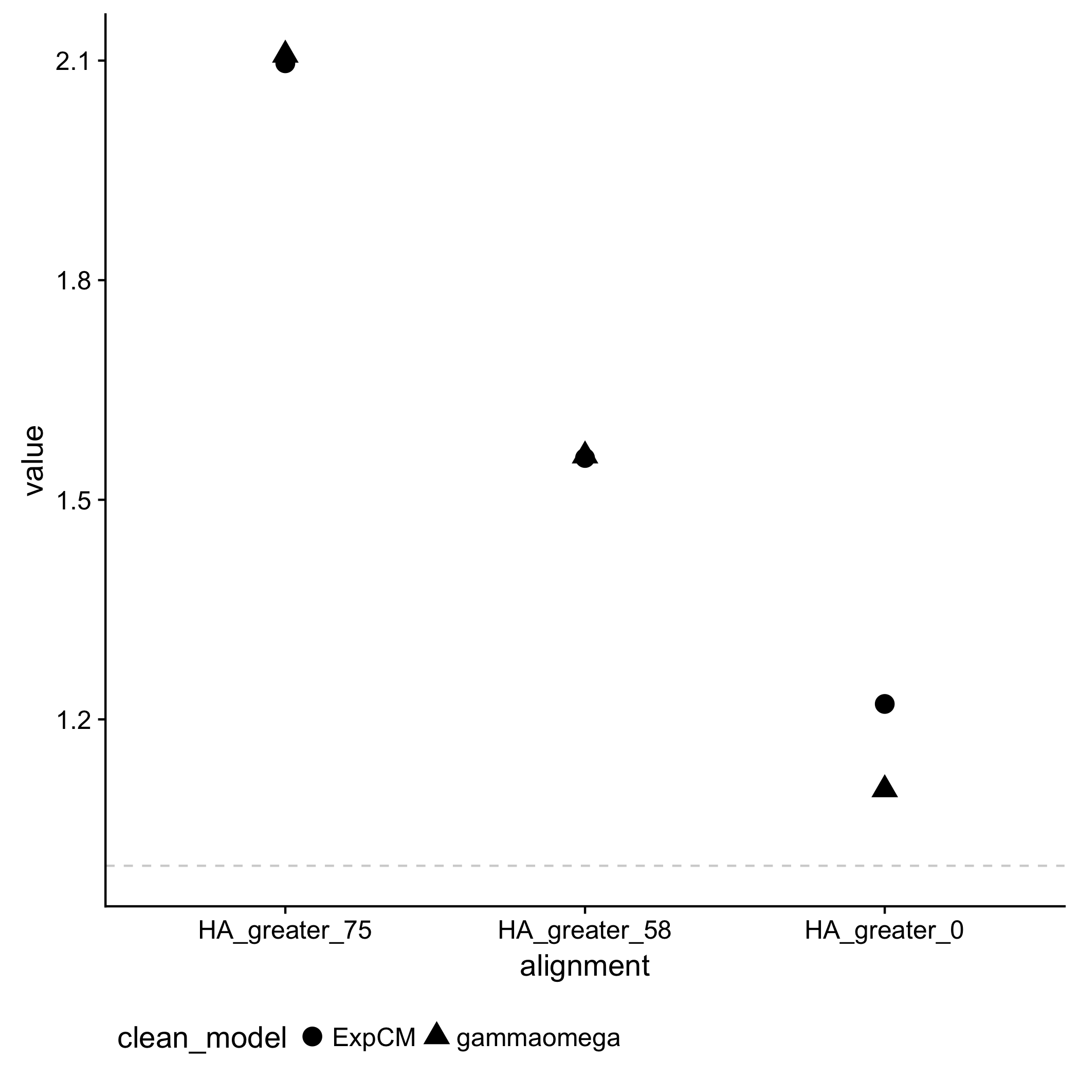
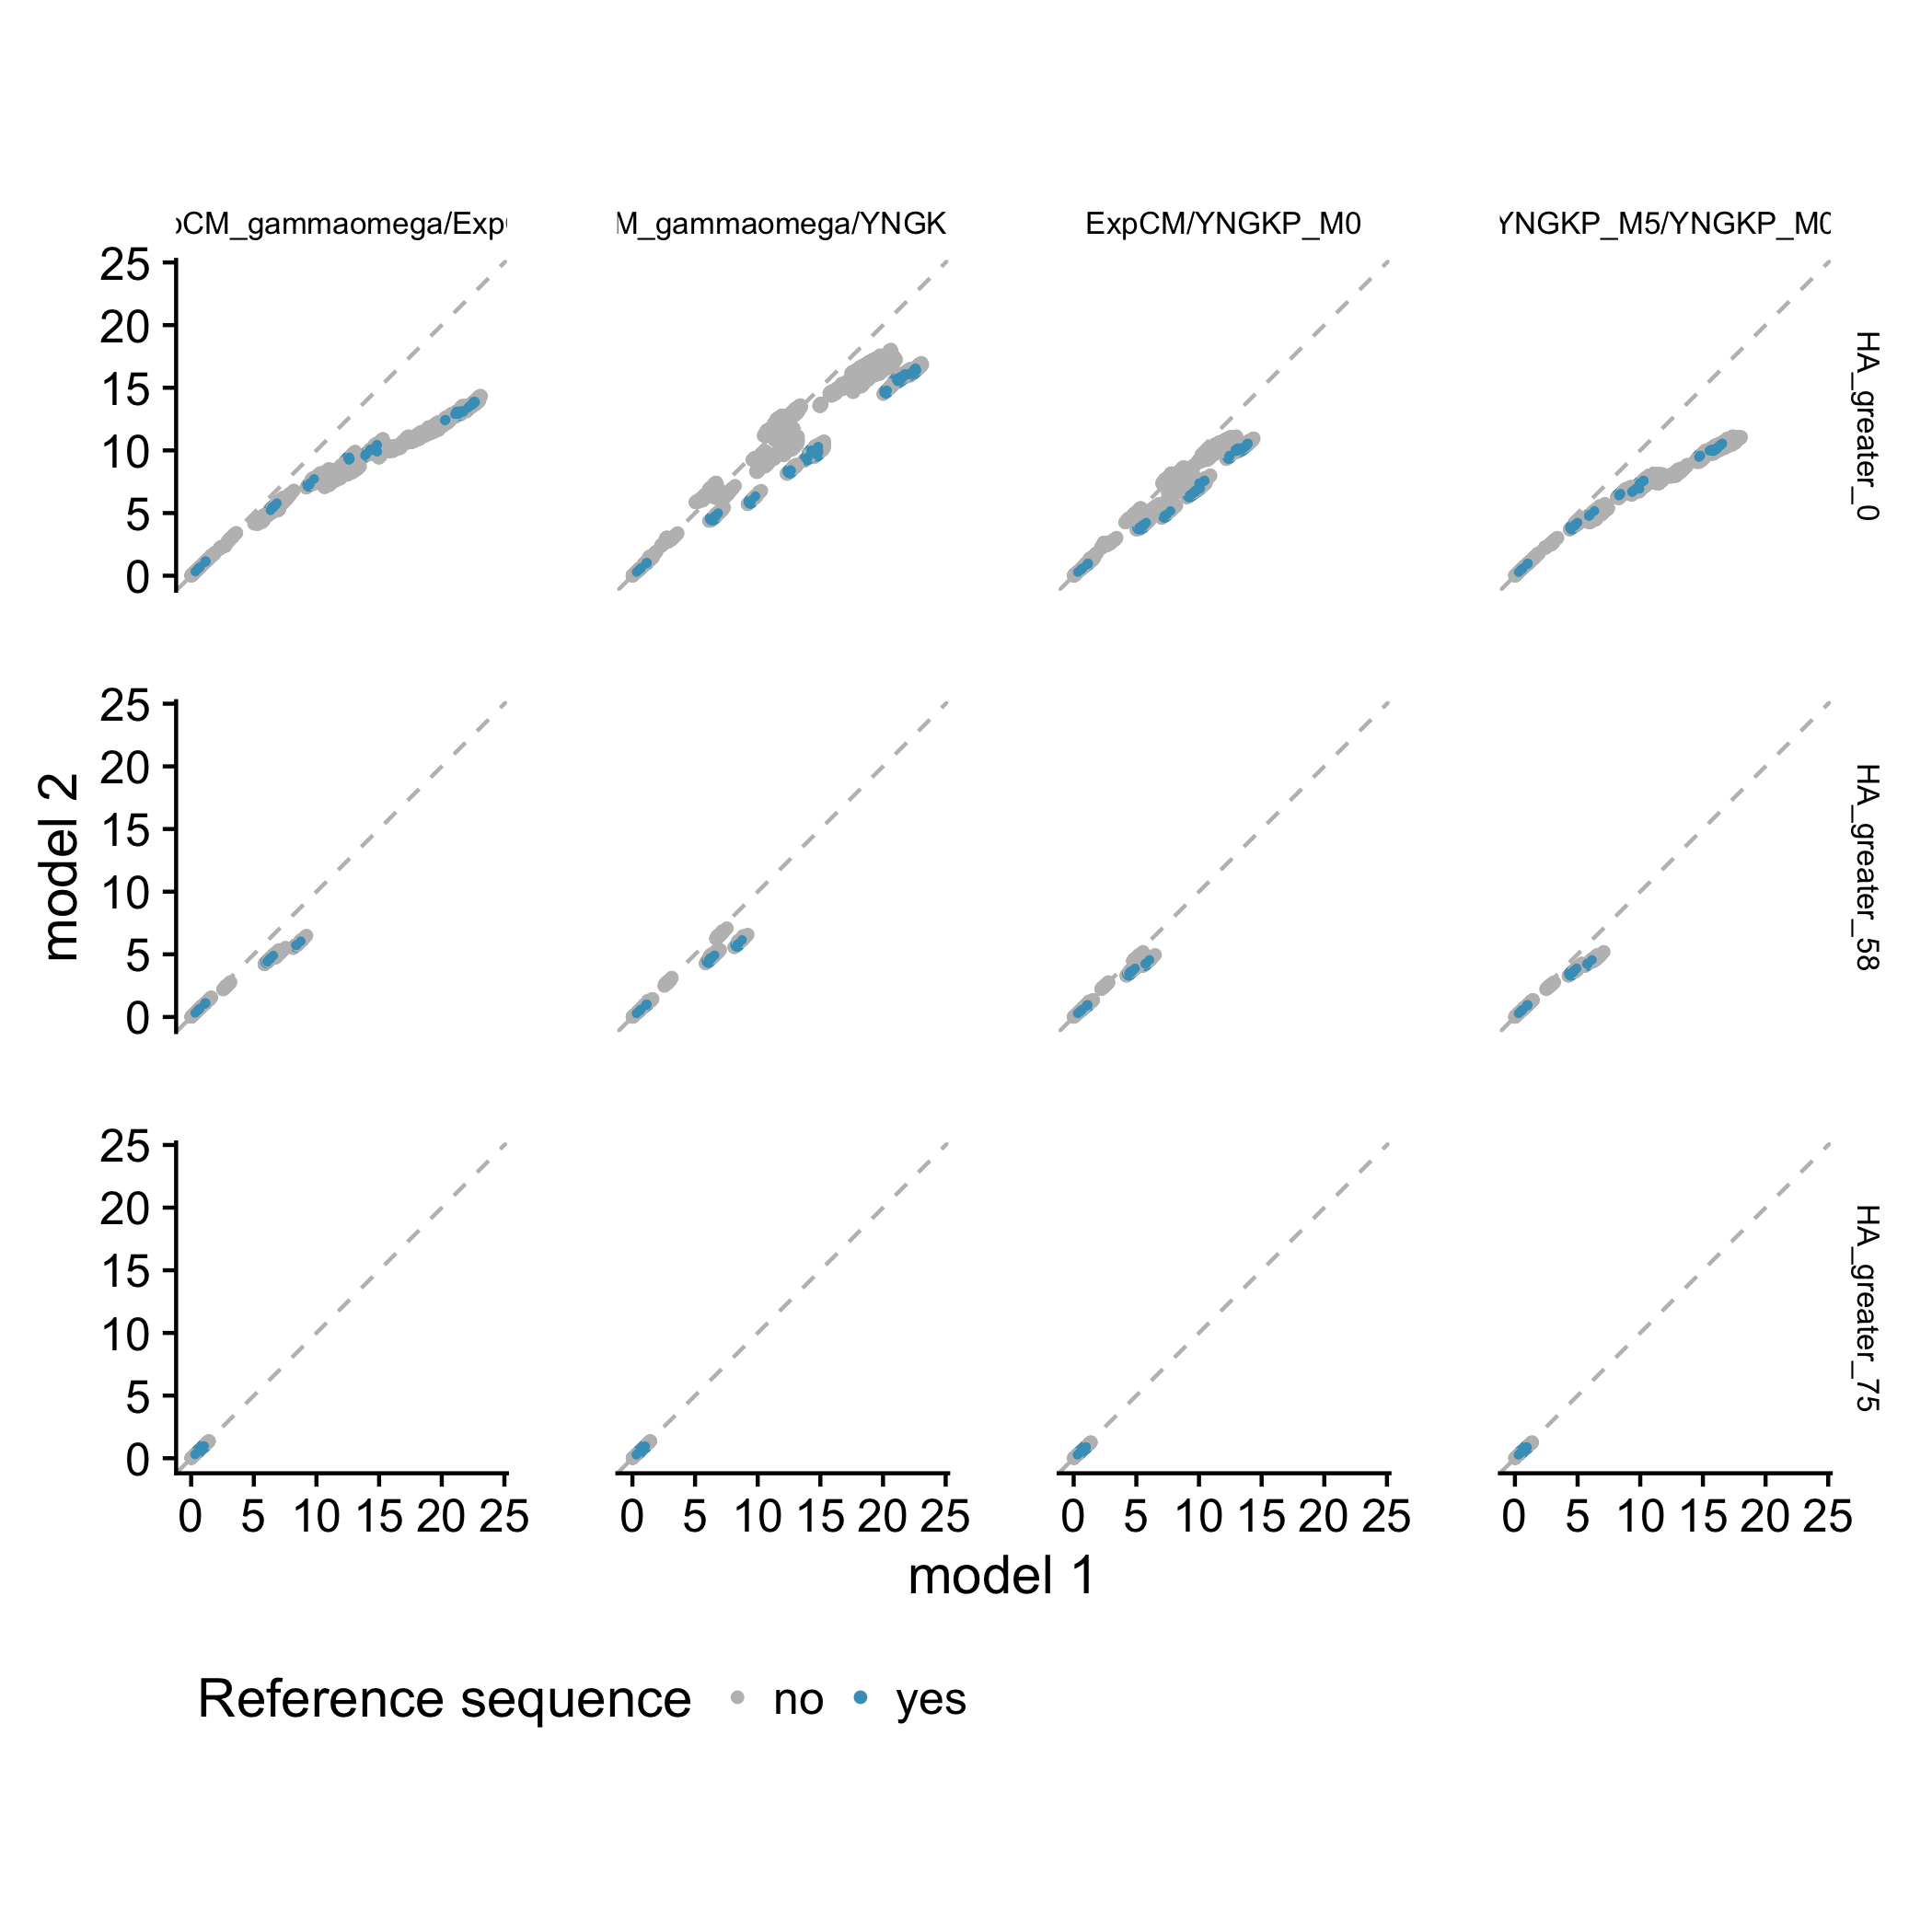
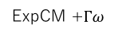
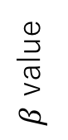
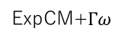
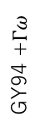
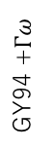
A
high
B
low
ExpCM
ExpCM +$Γω$
intermediate
$β$ value
Normalized branch length
low
high
intermediate
C
Branch from focal sequence?
Yes
No
ExpCM
GY94 +$Γω$
GY94
GY94
high
ExpCM
GY94 +$Γω$
GY94
GY94
intermediate
ExpCM
GY94 +$Γω$
GY94
GY94
low
ExpCM+$Γω$
ExpCM+$Γω$
ExpCM
YNGKP M5

Slide 23
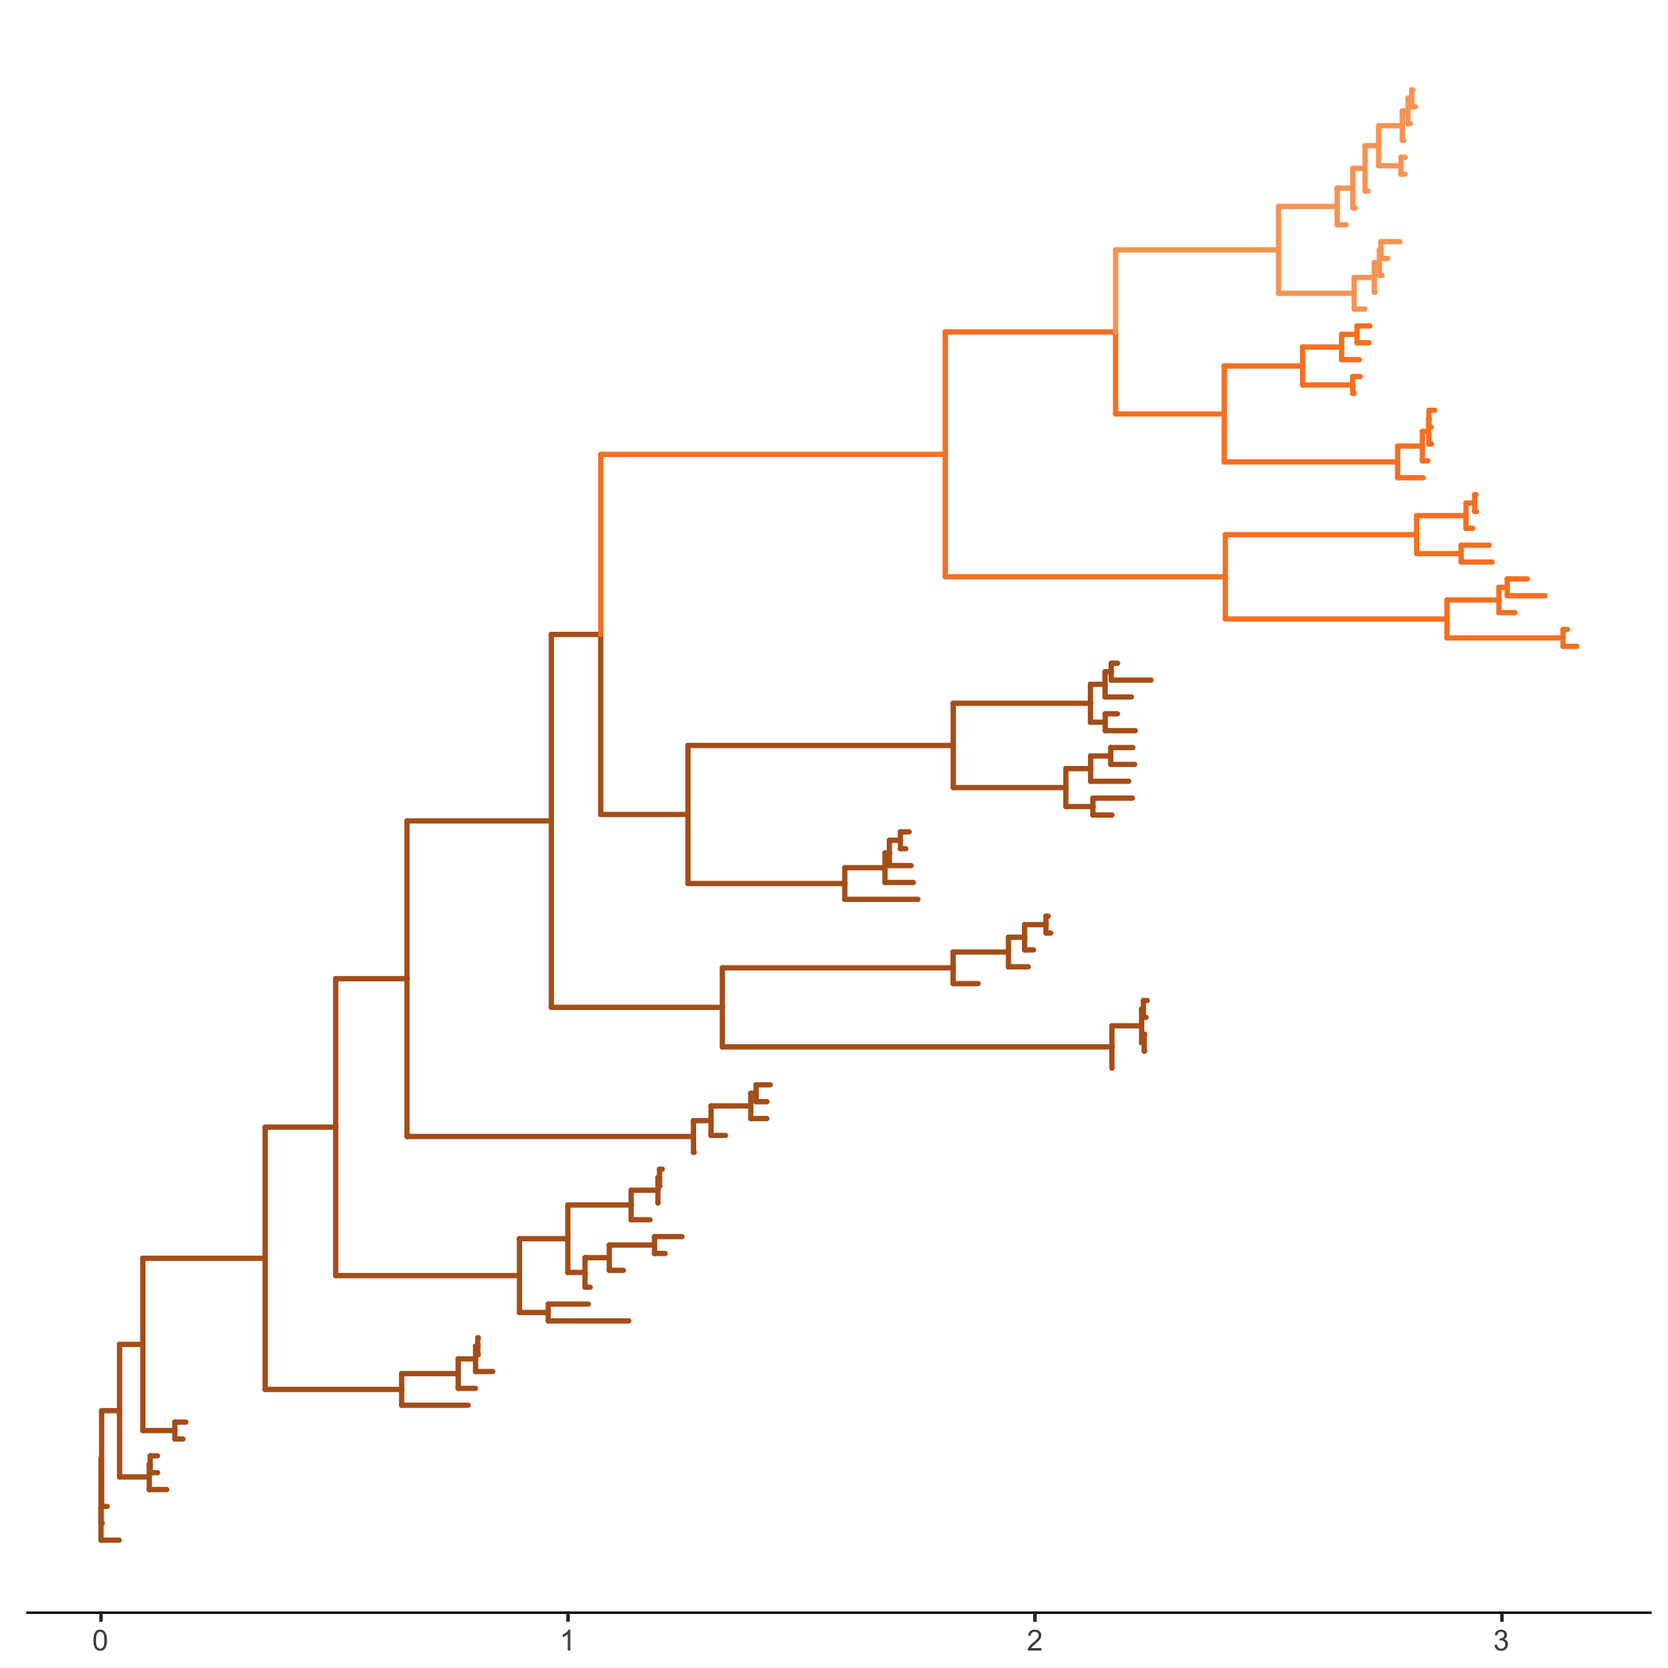
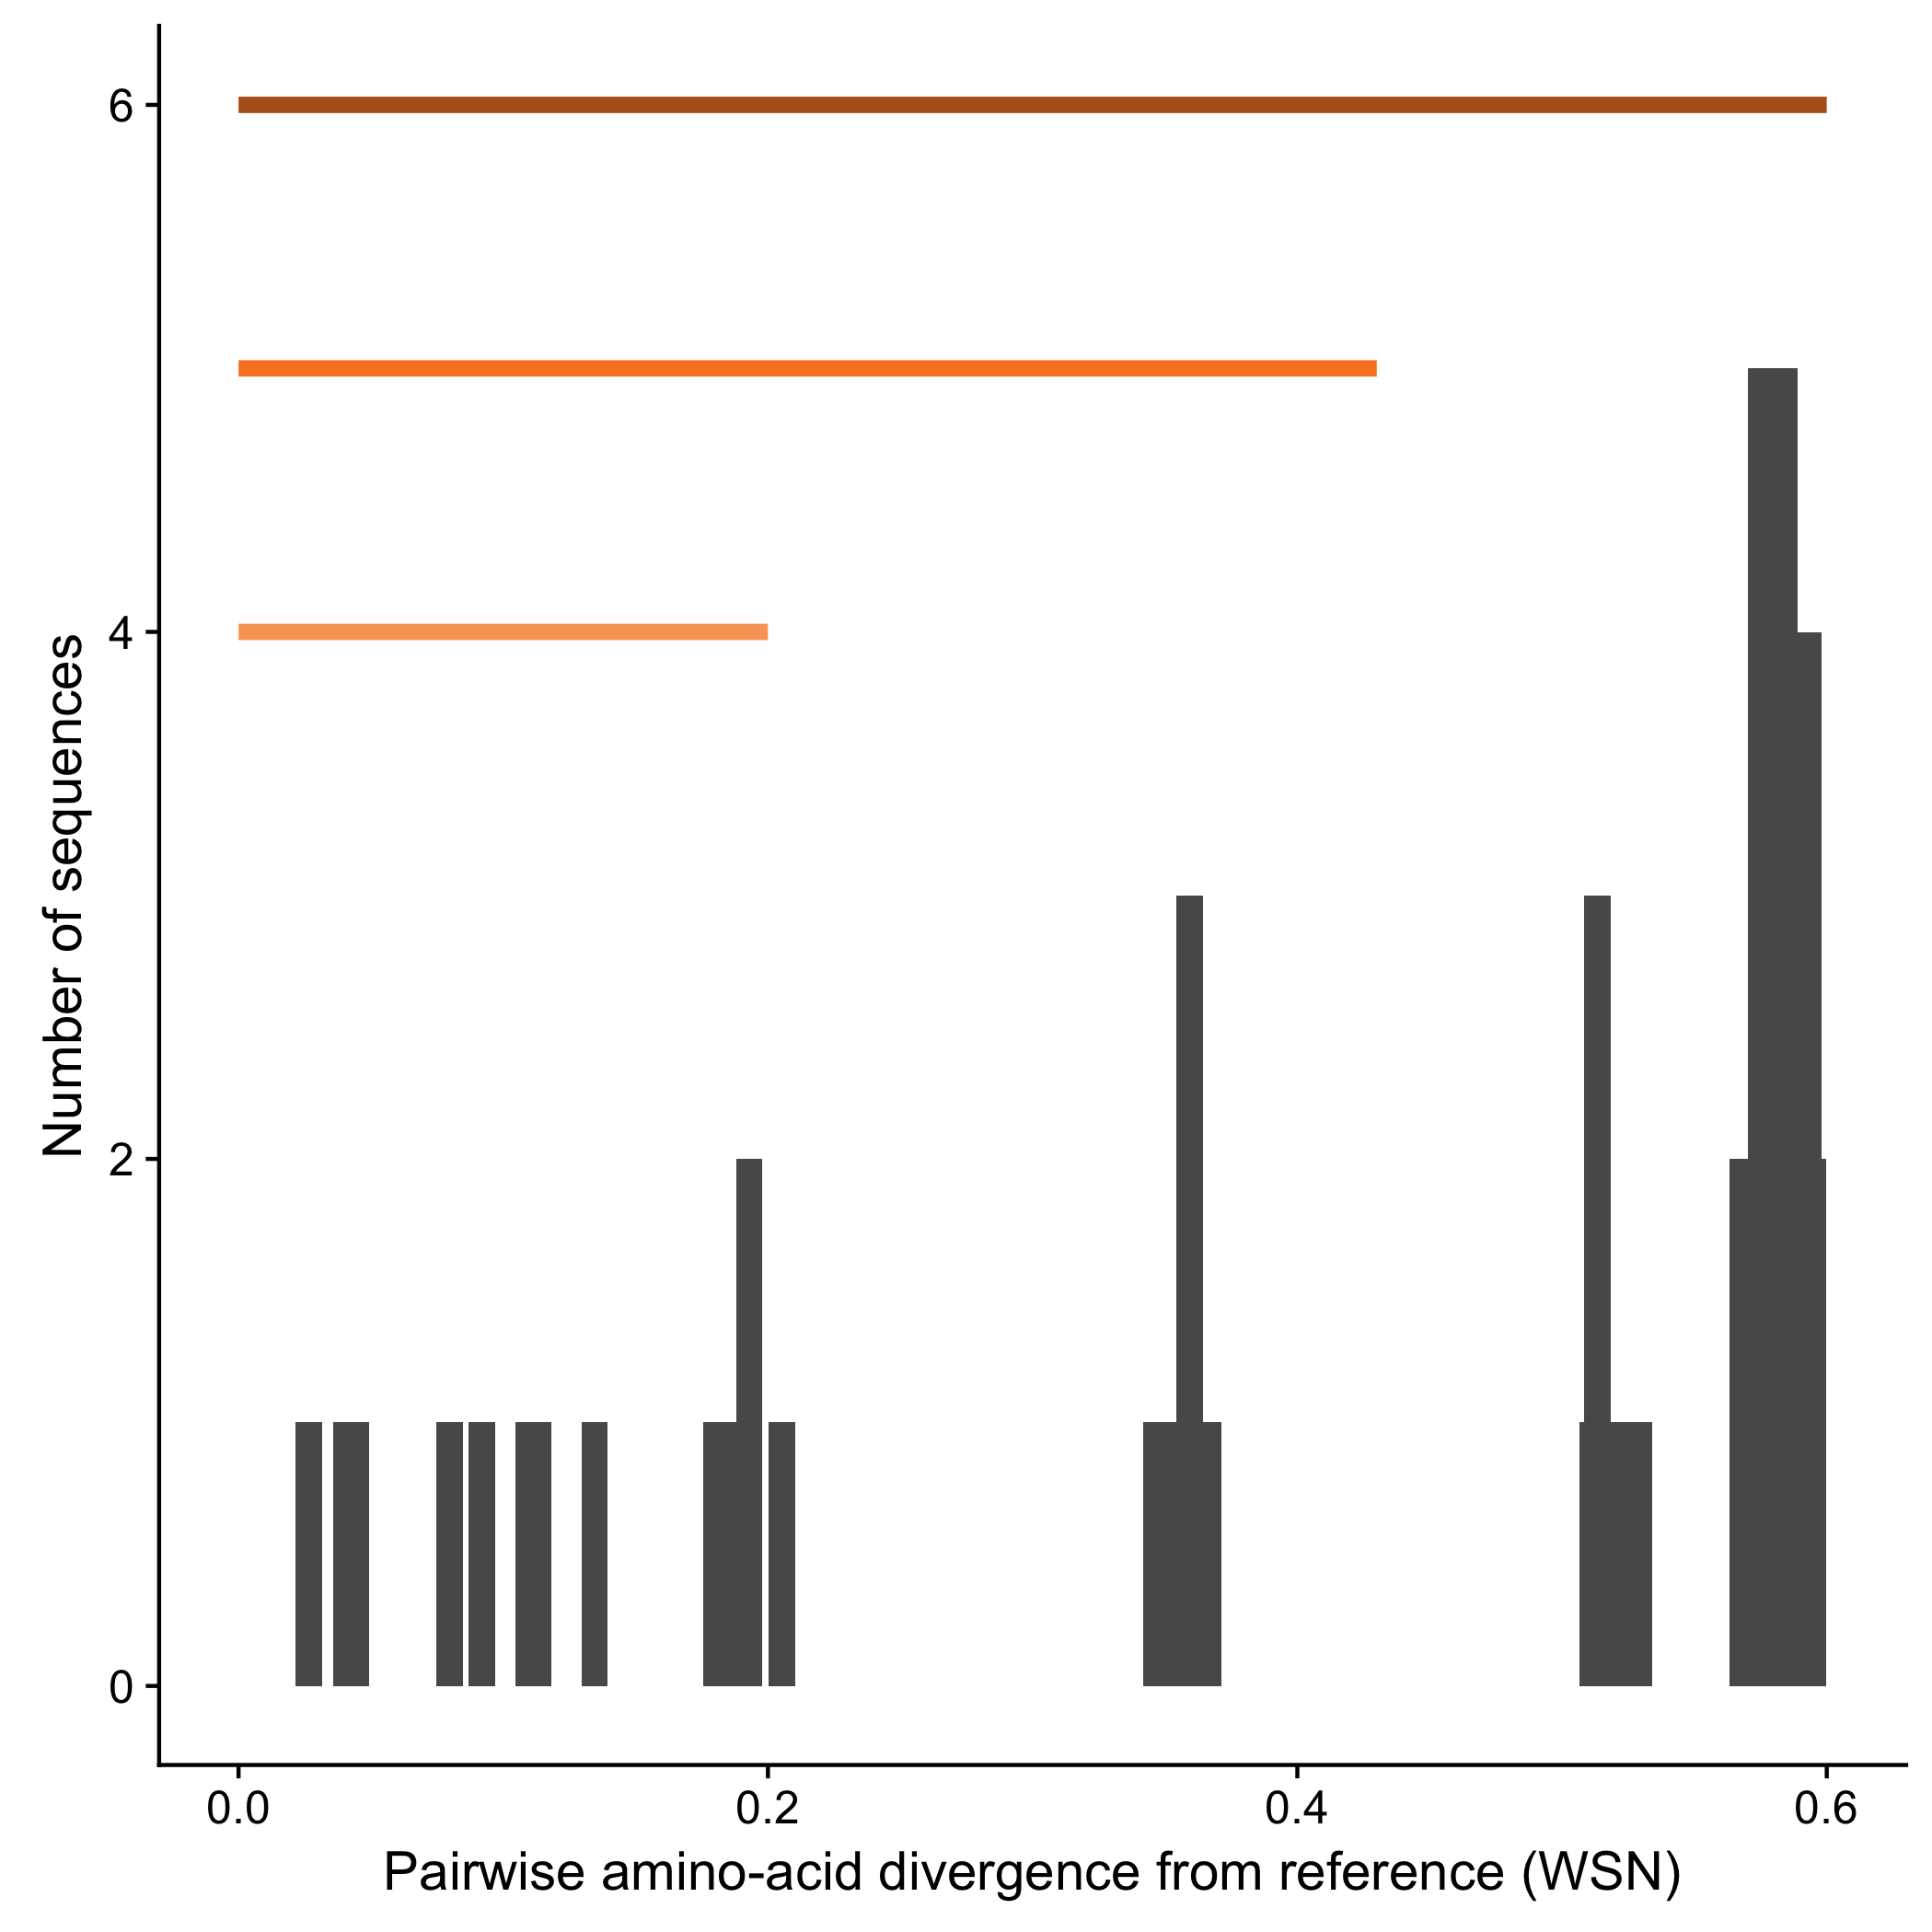
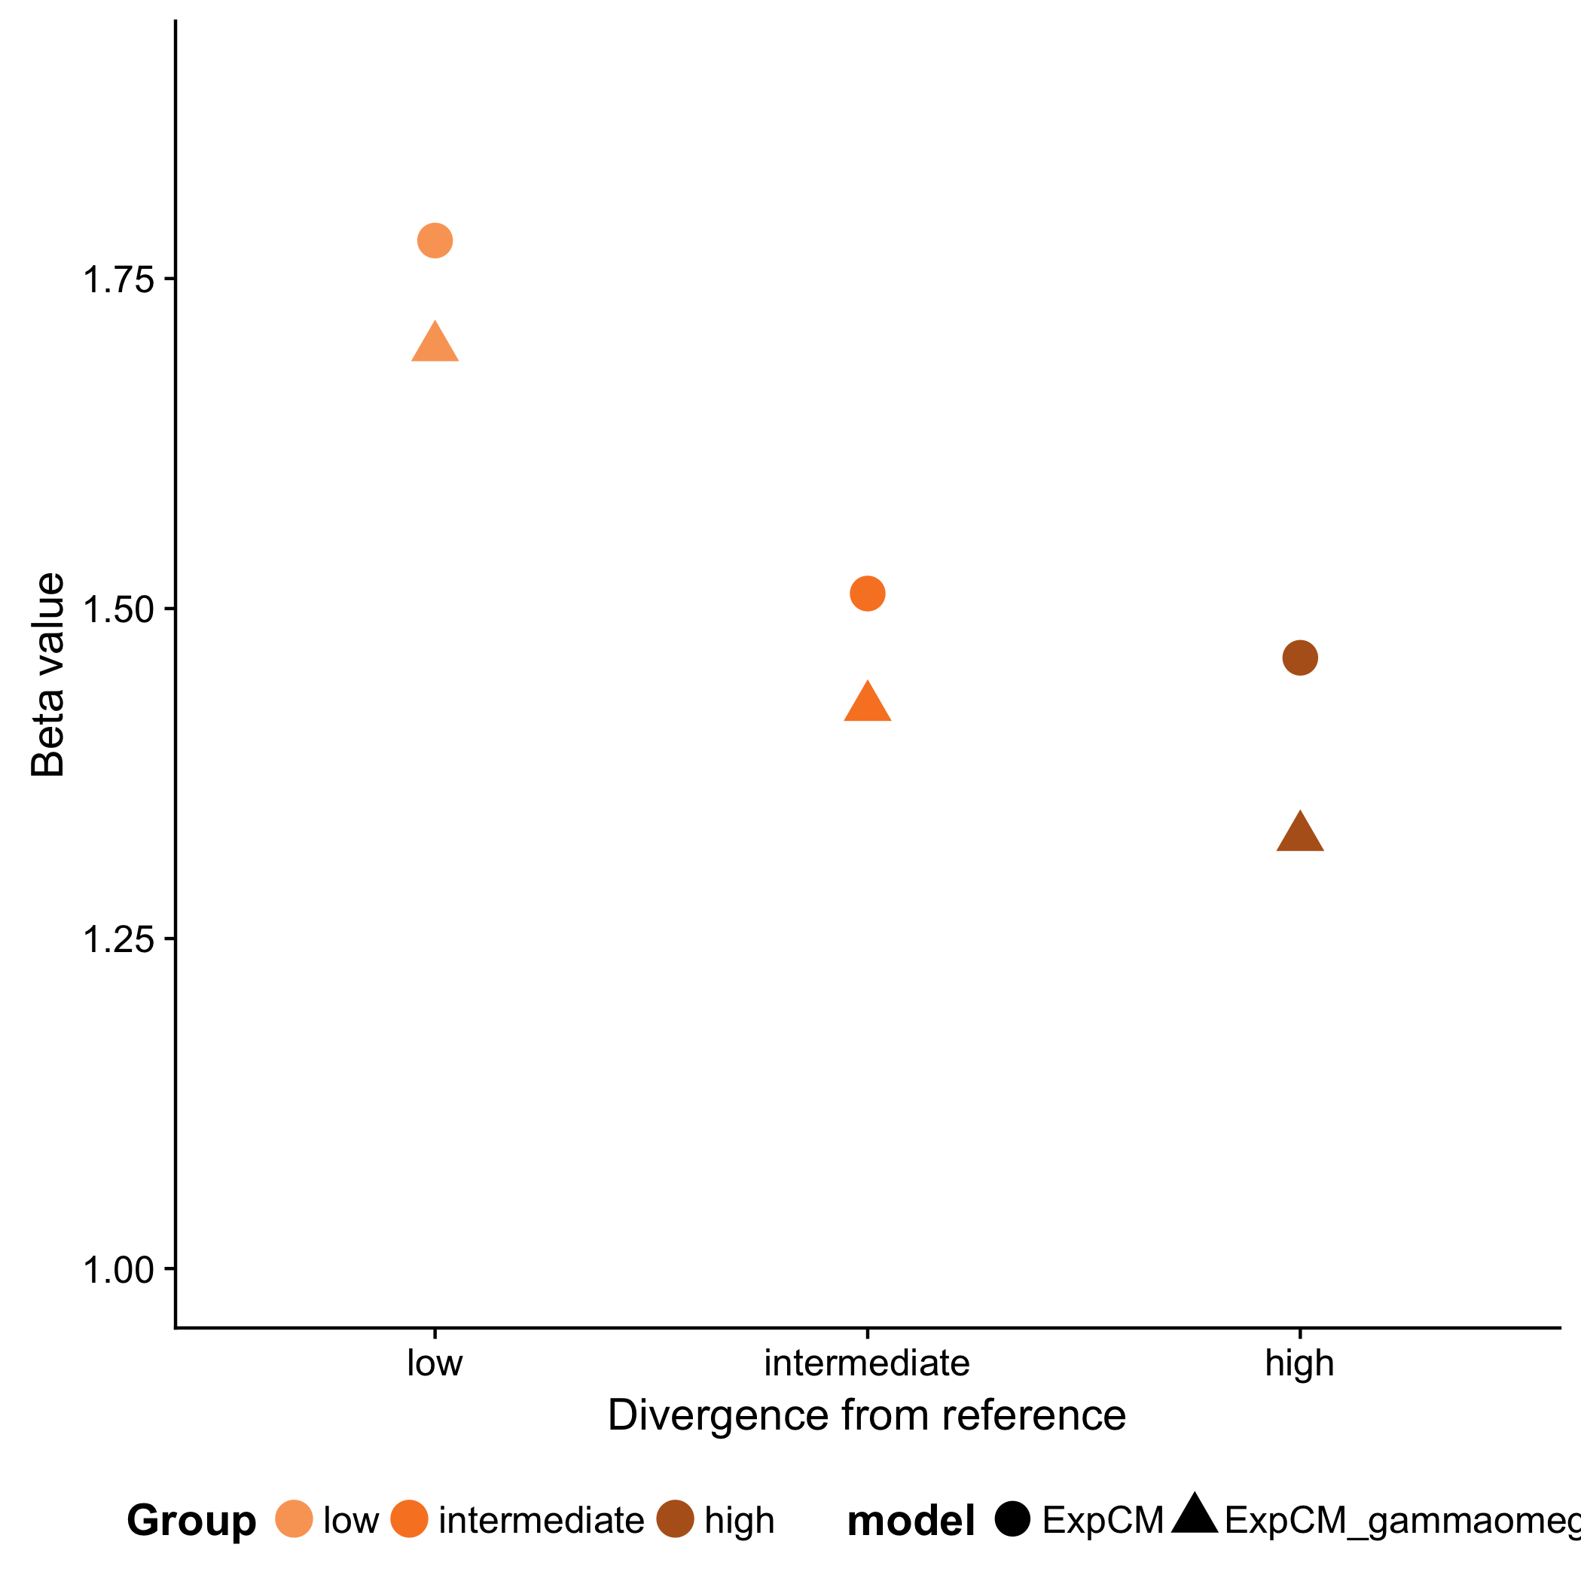
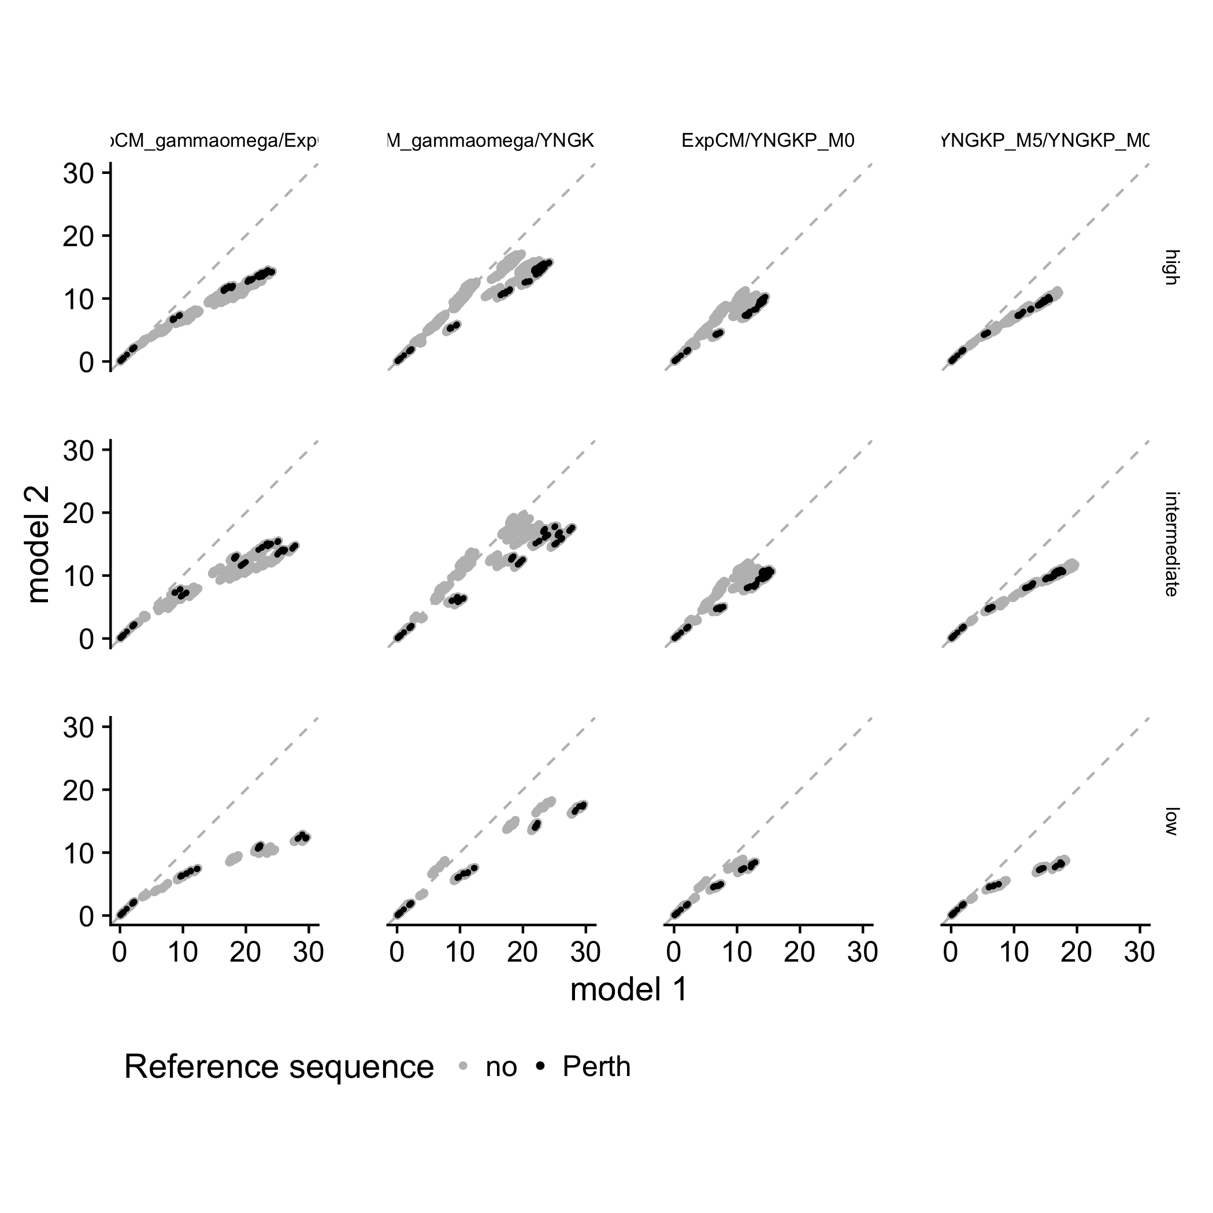
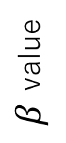
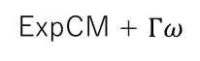
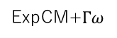
A
B
low to high divergence
low to intermediate divergence
low divergence
Number of sequences
Amino-acid divergence from focal sequence
Branch length
(average nucleotide substitutions per site)
C
D
Branch from focal sequence?
Yes
No
Model
ExpCM
ExpCM
YNKGP M5
YNKGP M0
YNKGP M0
high
ExpCM + $Γω$
Divergence level
$β$ value
ExpCM
YNKGP M5
YNKGP M0
YNKGP M0
intermediate
Branch length
ExpCM
YNKGP M5
YNKGP M0
YNKGP M0
low
ExpCM+$Γω$
ExpCM+$Γω$
ExpCM
YNGKP M5
Branch length
low
intermediate
high
Divergence from focal sequence

